Slide 1


Modern Analytics Platform
Assess and Manage AI and ML Data Platforms
Data Reply x Università di Bologna – Campus Cesena
Notes:
THANK YOU EVERYONE
WHY ANALYTICS PLATFORM

Slide 2


agenda
REPLY & DATA REPLY
ANALYTICS PLATFORM ASSESSMENT
DATA LAKEHOUSE
PLANNING A DATA PROJECT
Fabio Limardo
Senior Consultant
f.limardo@reply.it
www.reply.com/data-reply/it/
Info.data.it@reply.it

Slide 3

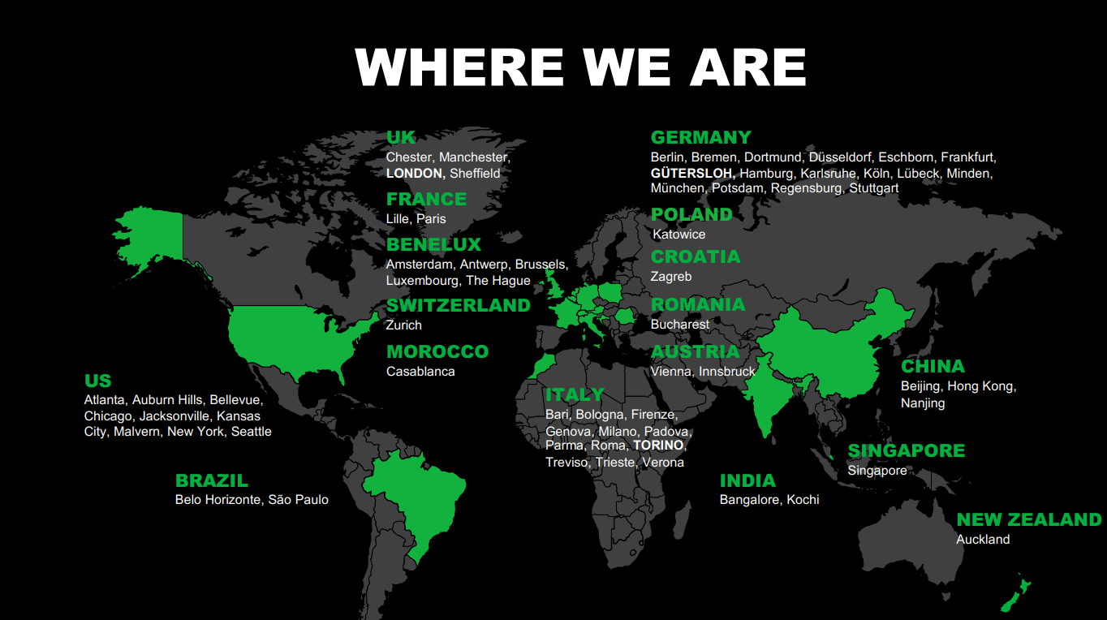

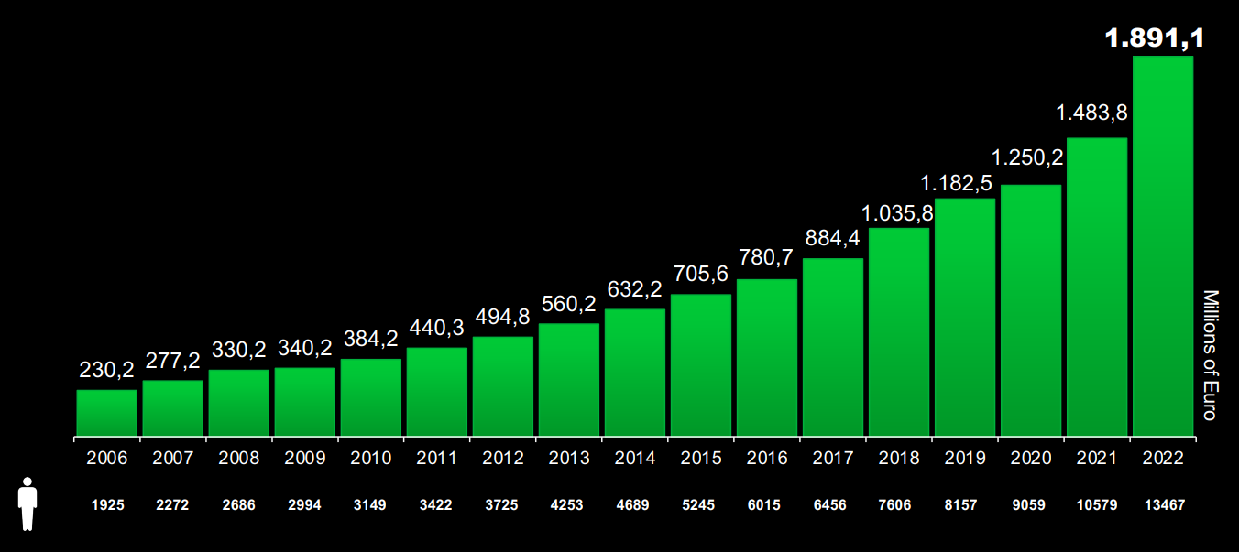

Reply is a network of companies highly specialized in technologies and industry sectors.
Our services include Consulting, System Integration and Digital Services, and we cover three main areas of competence: Processes, Applications and Technologies.

Slide 4
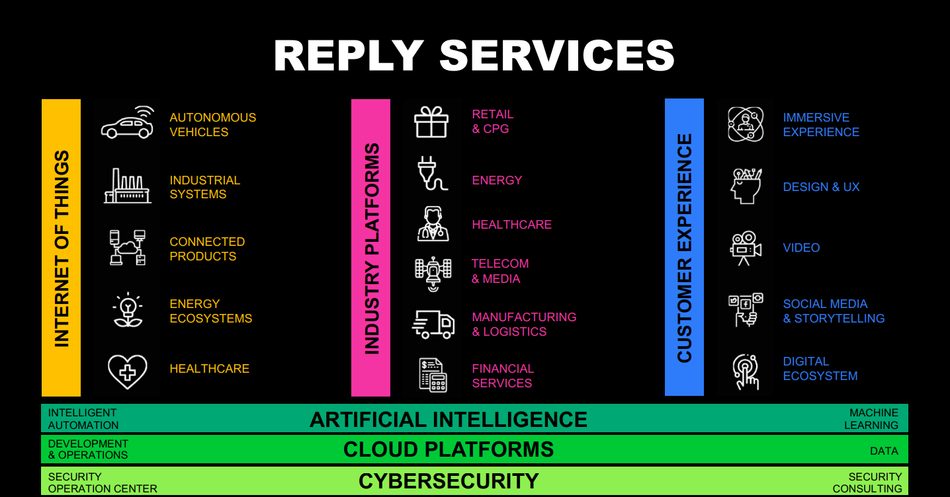

Slide 5
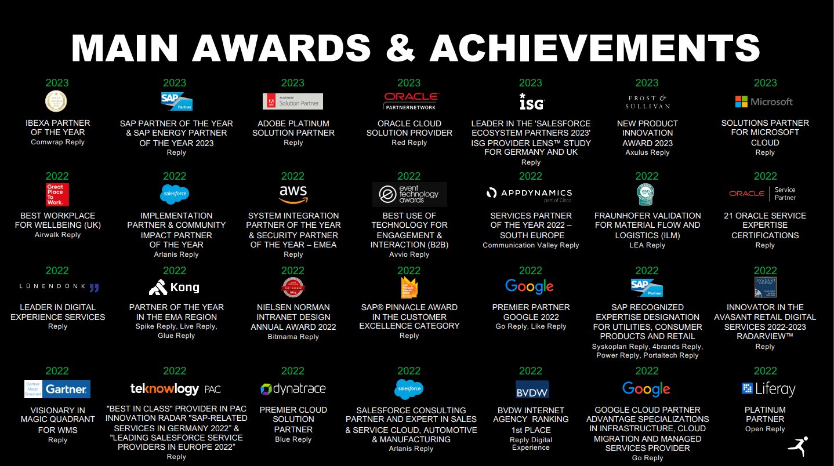

Slide 6


WE SUPPORT C-LEVELS TO EXTRACT VALUE FROM DATA
BIG DATA | ARTIFICIAL INTELLIGENCE | QUANTUM
In all industries and all business functions.
With more than 100 projects already delivered in production.
Confidential

Slide 7



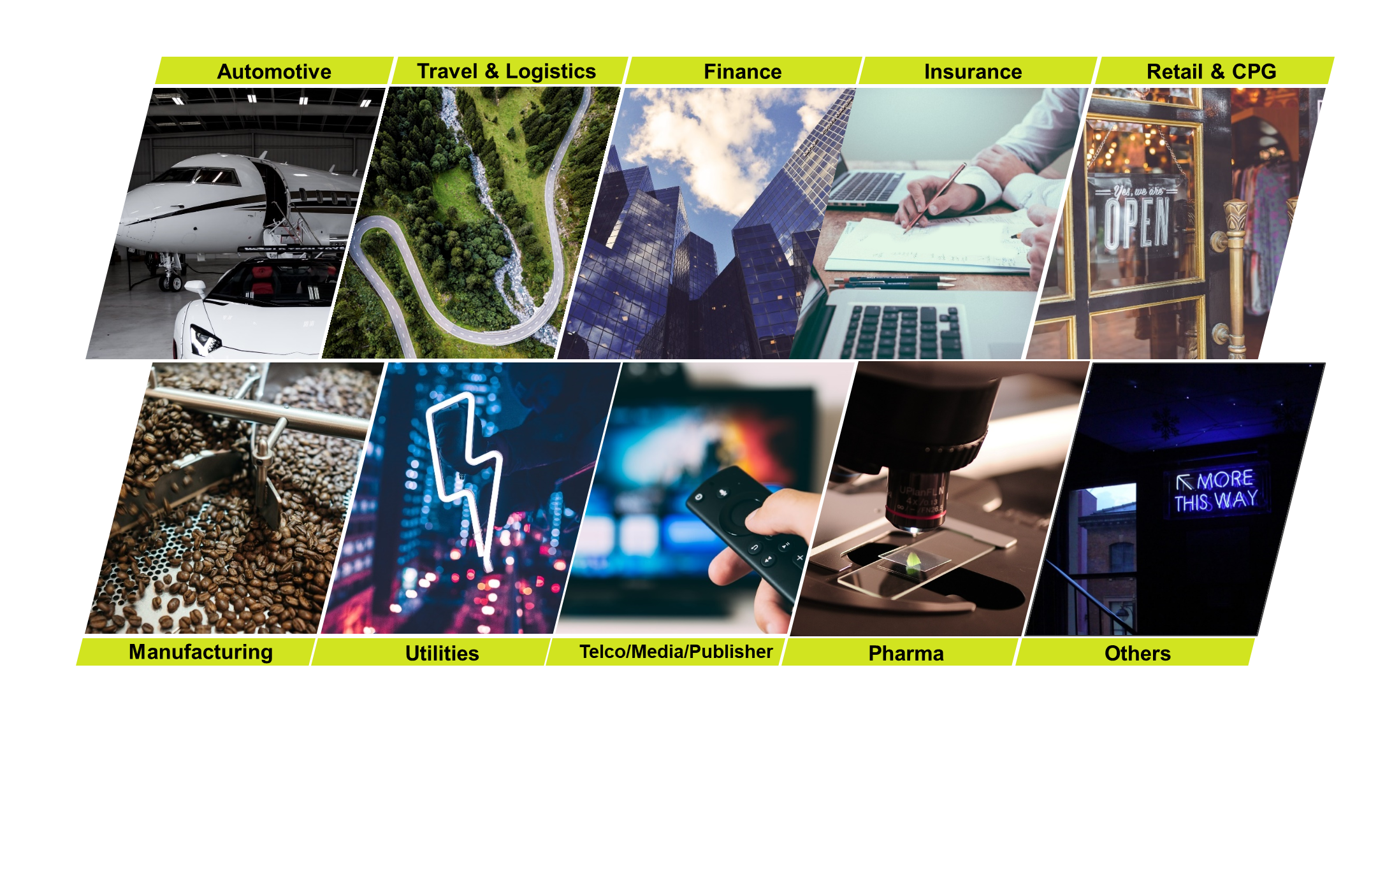
OUR EXPERTS:
Big Data Engineers & Data Scientists
BIG DATA & VISUALIZATION
Group of Big Data architects and developers with extended experience in Hadoop & NoSql solutions, both on-prem and in Cloud, and Data Visualization tools.
100+
Production projects, up and running
Data Science & AI
CROSS INDUSTRY
experience
Specialized in designing and implementing Advanced Analytics solutions, Artificial Intelligence and Machine Learning models.
Confidential

Slide 8







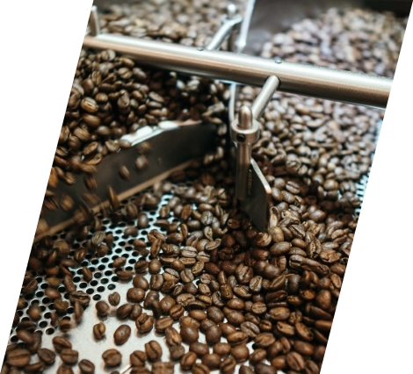




Automotive
INDUSTRIES
Travel & Logistics
Finance
Insurance
Retail & CPG
Manufacturing
Utilities
Telco/Media/Publisher
Pharma
Others
Confidential

Slide 9








Data reply - Vertical offering
SALES & MARKETING, AUTOMATION
RISK AND COMPLIANCE ANALYTICS & PLATFORMS
QUANTUM, OPTIMIZATION & ACCELERATED COMPUTING
BDE, OPS &OBSERVABILITY
ENERGY/INDUSTRY & SUPPLY CHAIN INTELLIGENCE
BDE FOR FSI & SECURITY
Confidential

Slide 10











Data reply - partnerships
AWS COMPETENCIES
Big Data
DevOps
Oracle
Migration
IoT
Industrial
Software
SaaS
Machine
Learning
Security
Financial
Retail
Energy
Confidential

Slide 11







collaborations
Confidential

Slide 12











Scientific publications on peer reviewed Journals
Confidential

Slide 13

















Data reply EXPERTISE
SALES & MARKETING ANALYTICS
BIGDATA ENGINEERING & SECURITY INTELLIGENCE
ENTERPRISE ANALYTICS
INDUSTRY & IOT ANALYTICS
QUANTUM & GPU ACCELERATED COMPUTING
MARKETING INTELLIGENCE
SALES INTELLIGENCE
GRAPH DATA SCIENCE
SECURITY INTELLIGENCE
SPACE INTELLIGENCE
AI 4 OPS
ACCELERATED COMPUTING
DATA PLATFORMS
UNIVERSAL QUANTUM COMPUTING
RISK DATA PLATFORMS
QUANTUM OPTIMIZATION
DATA PLATFORMS for AUDIT & COMPLIANCE
Operational Excellence
AI for Green Transition
Advanced Forecasting
AI FOR IPA
Confidential

Slide 14


























































DATABASE NO SQL
INDEXING
CONTAINERIZATION
DATA REPLY
TECHNOLOGIES
EXPERTISE
DATA SCIENCE LIBRARIES
DATA VISUALIZATION
LANGUAGES E FRAMEWORK
ACCELERATED COMPUTING
BIG DATA PLATFORM
CLOUD PLATFORM
ETL TOOLS
DS TOOLS
GENERATIVE AI
Confidential
Notes:
@montinari

Slide 15
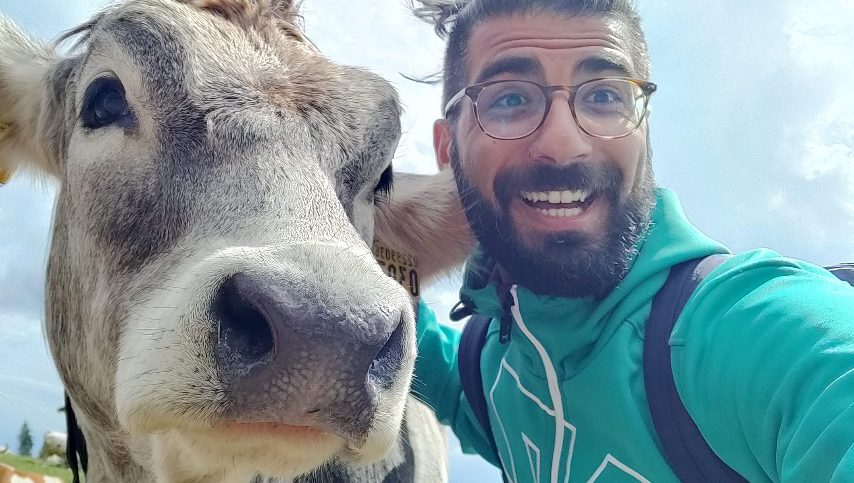
Why does Data Reply give money to Fabio?

Slide 16
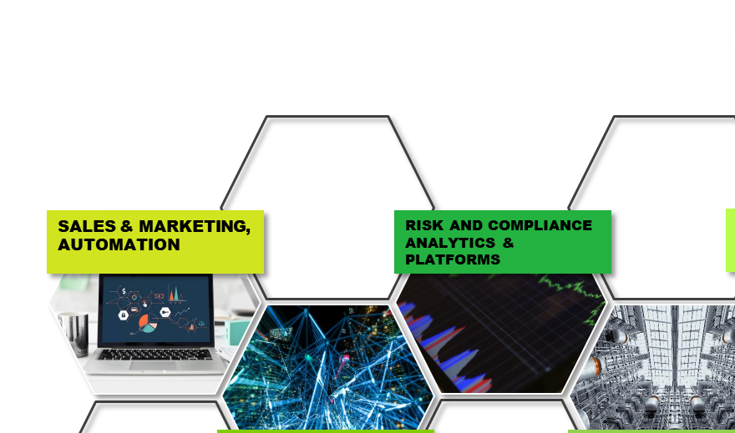
SALES & MARKETING, AUTOMATION

Slide 17


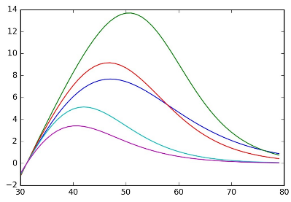
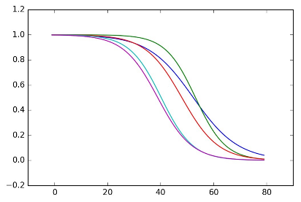
Client: Media
CLV Forecasting
Need of collection and ingestion of cost data in Data Lake in a single stable source
Extend an existing churn model to a longer time horizon from 3 to 12 months and projecting the result to 3 years
Predict the future value, in terms of revenues, of a customer in a high variable and dynamic context and extend it to 3 years
Integrate the future business actions and decisions in order to improve the final model performances
The customer is a global leader media company
They need a new model that integrates the churn risk knowledge, as survival probability, with the prediction of the future net margin bring by the customer in order to forecast the Customer Lifetime Value for each client
The desired model time horizon is three years
€
Financial Contribution
Survival Time Period
Churn Model and Net Revenue model have been developed in python and later combined in Google Big Query:
Churn model is trained on segments of the customer base, one model for 3,6,9 and 12 months. The algorithm used is a LightGBM Classifier.
Net revenue model is trained to all the customer base and it aims to predict the entity of the difference in the future revenue in time horizons of 3,6,9 and 12 months. The algorithm used is a LightGBM Tweedie Regressor
The prediction at 3 years is projected with interpolation of the predictions obtained with the previous models.
CLV value is calculated as a combination of the financial contribution and survival probability with advanced mathematical logics.
CLV =
X
Provide CLV as a new metric in order to understand, segment and classify the customers based on their predicted future monetary value
Monitoring overall customer base value trends
Timely forecast results on 3 years
Provide a new KPI that can be exploit for Marketing and Campaign actions

Slide 18


Client: Fashion
PROMO OPTIMIZATION
Deal with heterogeneous sales behaviors (recurrent, seasonal, sporadic..)
Not all products had price changes in the past.
Take into account different constraints for the different channels.
The client is a American brand of fashion that sells all over the world
The client is one of the most known brand for bottom wear
Multiple promotions are planned during the year, both online and in the stores.
Due to COVID emergency the main goal is to maximise revenues and sell-through.
Retrieve the data stored in AWS S3 through Spark
Data preparation and pre-processing on Dataiku.
Hierarchical approach for building elasticity curves
Optimization model to identify the best discount for each product, given a set of constraints.
Increase in revenues (2 times more in e-comm, 1 time more in Retail)
Increase in sell-trough (5 times more in e-comm, 2 times more in Retail)
Specific level of margin preserved

Slide 19




MY story (Long story short)
2017 - 2018
2020 - Now
Data Engineer
Project Manager
Bonus
Spark, ETL Pipeline, AWS
Assess and Manage Data Platform
Data and
Business Analyst
Earth Observation
via
Space Technology
Business Process, Data Mapping, Data Analysis
2018 - 2020

Slide 20

Analytics Platform
Assessment
From the Datawarehouse to the Data Lakehouse

Slide 21
What is an assessment
Cambridge Def: the act of judging or deciding the amount, value, quality, or importance of something, or the judgment or decision that is made
AS – IS ANALYSIS
TO – BE ANALYSIS
TO – BE DESIGN
PLAN

Slide 22

ANALYSIS AS IS Solution
Functional organisation of the data ecosystem
Logical and technical architecture
Data ecosystem dimensioning (cardinality of technological components, data volume, userstiming and SLA/CutOff)
Detail of the technology components (data flows, data source, ETL and transformations, data layerdata, reporting components)
Notes:
SILOS – CRM vs COMMERCE -> DWH
Data mapping process UML ER MAPPING?

Slide 23
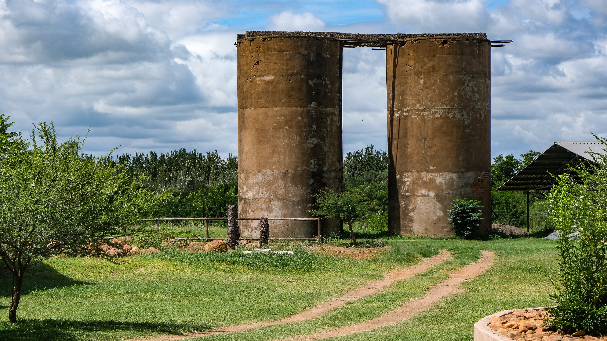
Functional organization as Silos

Slide 24





Business Process and data mapping
Interviews
Business
IT - Tech
You
SQL
Data
Match?
Feedback
Match?

Slide 25

Analysis To-Be solution
Limitations of the current solution with respect to modern data centric infrastructures (enabling factors to the advanced analytics)
Drivers for evaluating the new solution
New use cases to be enabled
Notes:
Lack in Governance
Use cases
Lineage
GDPR
-> Driver Performance and Costs?
Business Value?

Slide 26

DEsign To-Be solution
Vendor selection
Logical and technical architecture of the To-Be solution
Dimensioning of To-Be solution components
LakeHouse

Slide 27
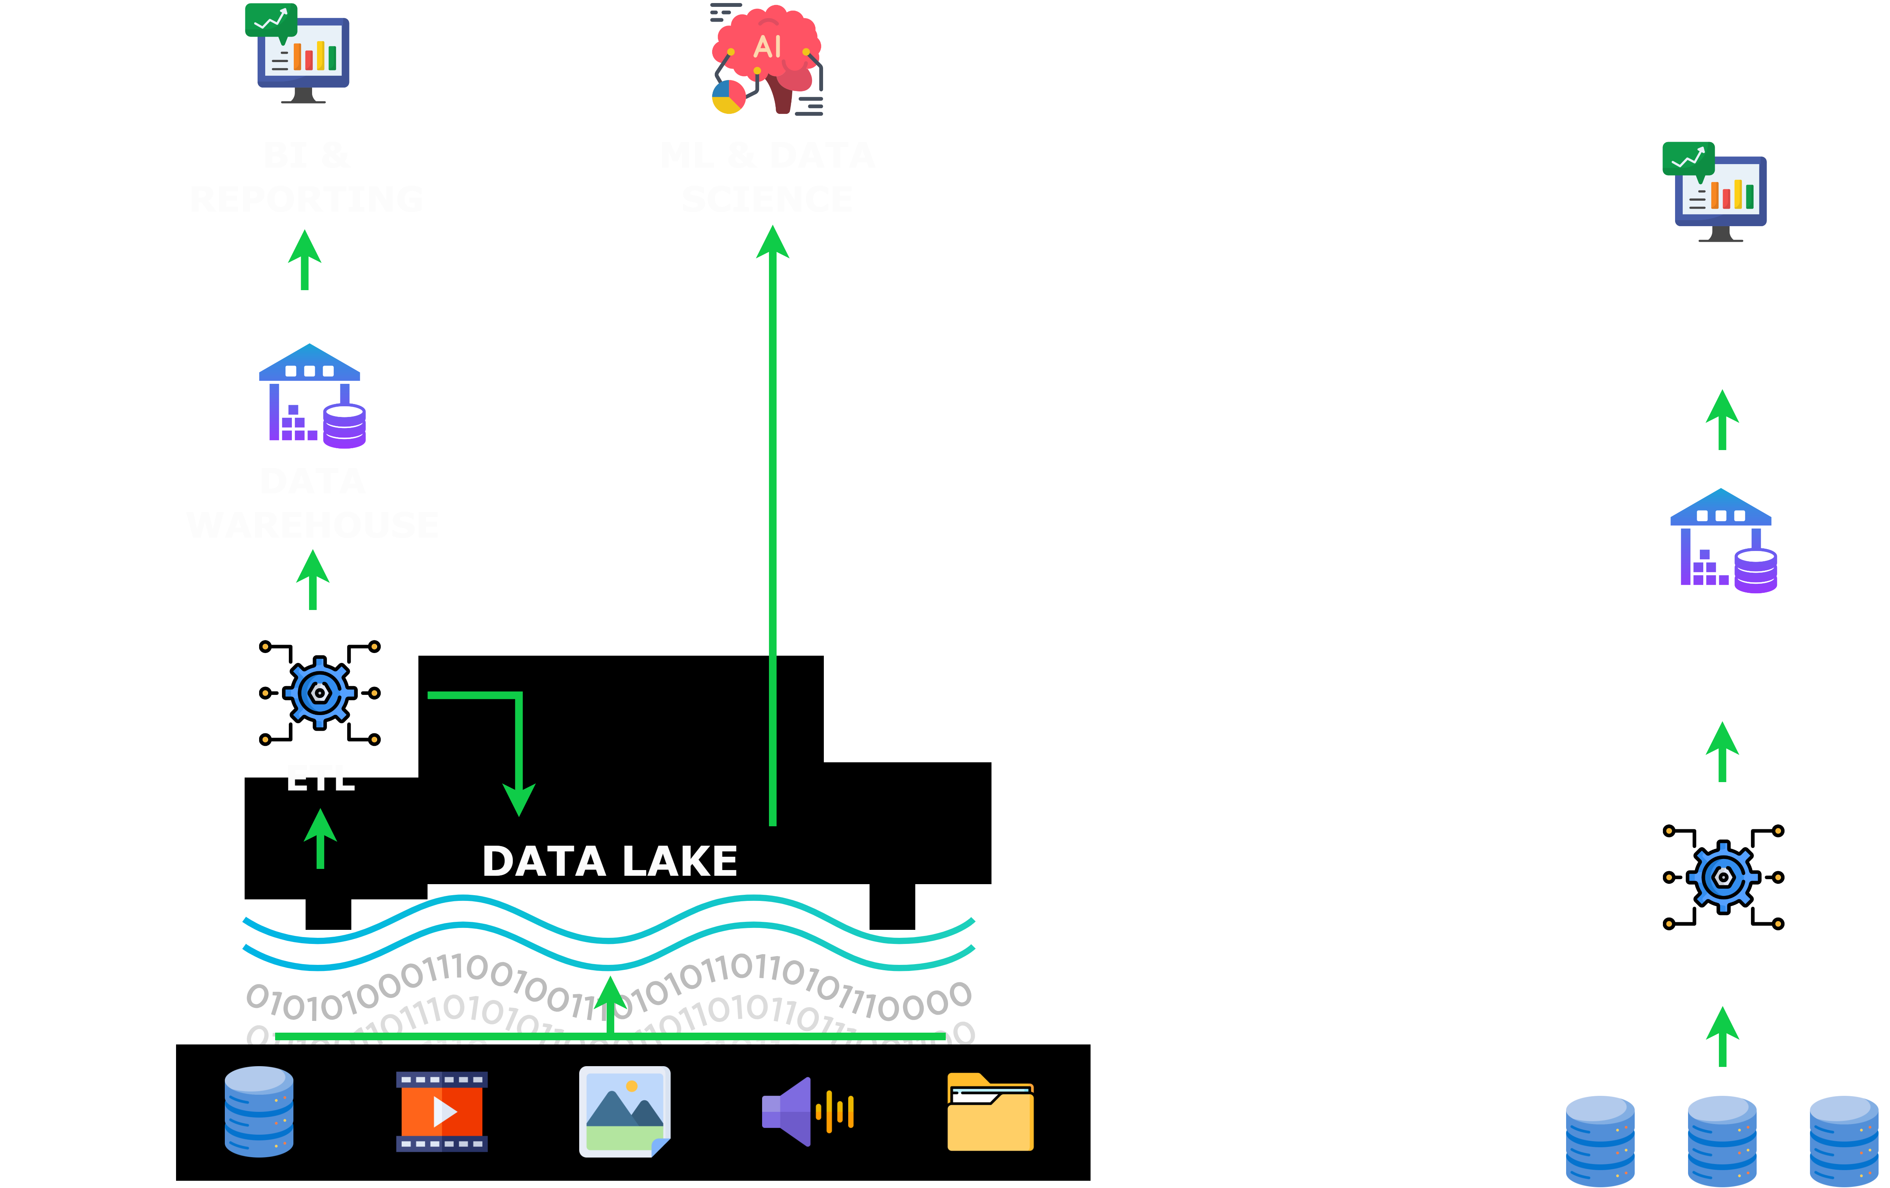
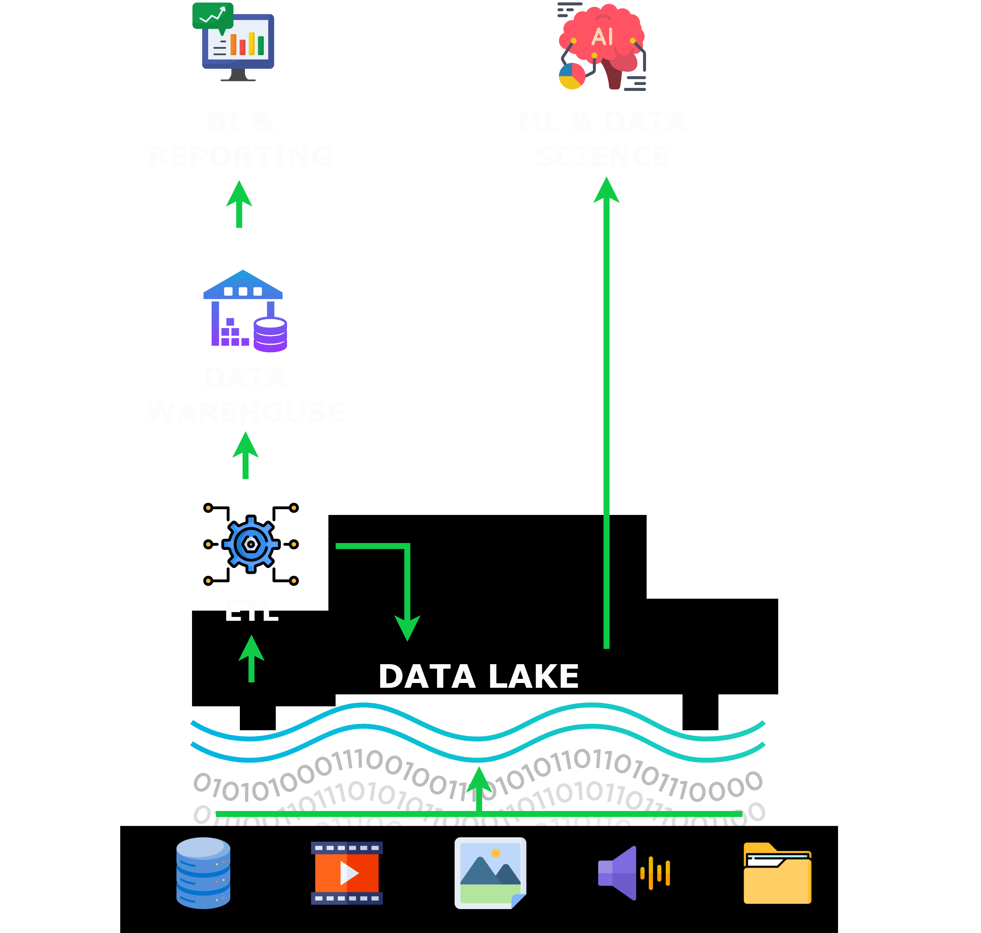
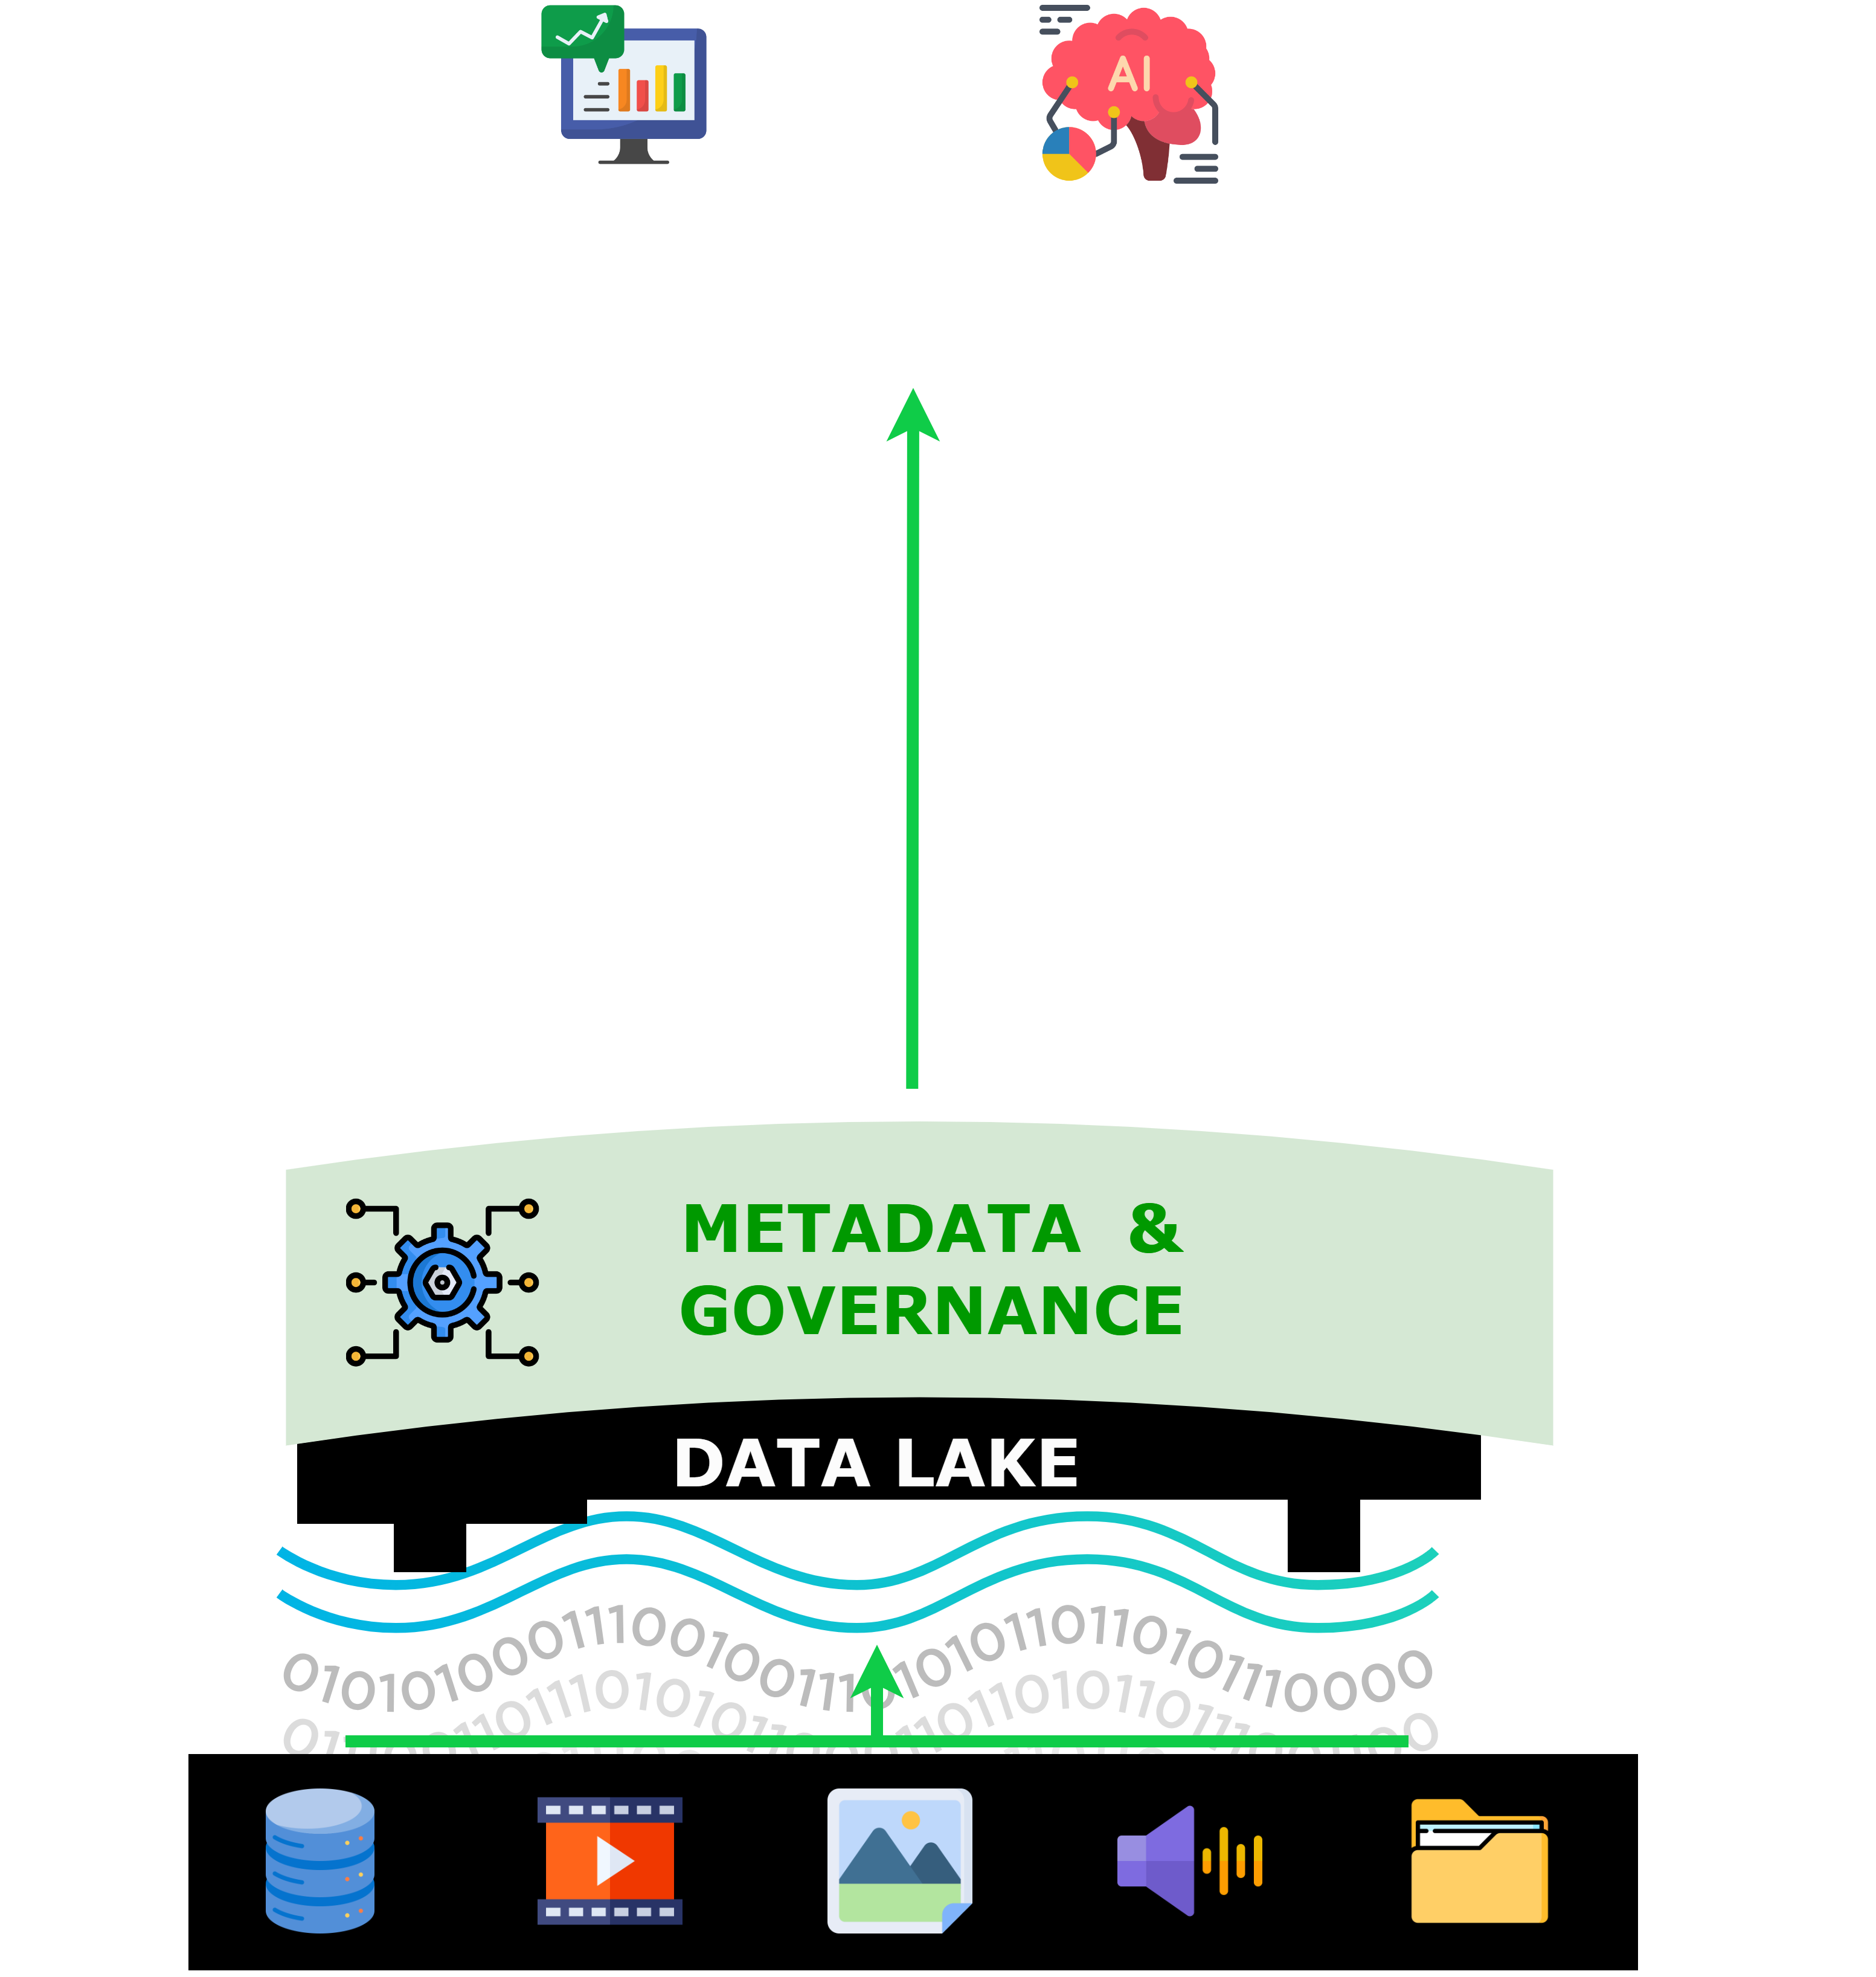
DESIGN TO-BE SOLUTION
SOLUTION DESIGN
First Gen Data Platform
Second Gen Data Platform
Modern Data Platform

Slide 28
Data warehouse vs data lake
features
Data Warehouse | Data Lake
MPP OLAP architecture | Centralized repository
Structured data | Structured and unstructured data
ETL processes feed the centralized dwh with raw data coming from different sources | Store data at one location in an open format ready to be read
BI and batch analytics use cases | BI, batch and real-time analytics, ML use cases
Schema on write | Schema on read
Coupled storage and computation | Decoupled storage and computation
Costly data storage | Cost-effective data storage

Slide 29
Data warehouse vs data lake
issues
Feature | Data Warehouse | Data Lake
Input data | Not suited for handling unstructured, semi-structured, high variety or high velocity data | Complex ETL pipelines to build the data lake
Storage | Too expensive | Since data is stored in original format, its analyzation requires high technical expertise
Architecture | Tightly coupled storage and processing | Query performance may be degraded
Flexibility | Lack in flexibility: difficult to adapt to new requirements Lots of information not included in the main question difficult to access | Issues with data security and governance Issues with data quality
Use cases | Not the best solution for ML use cases | Risk of dealing with data swamps

Slide 30


Modern data platform
Steps towards lakehouse
Support for external tables in Parquet and ORC formats
ETL complexity, staleness and advanced analytics challenges still remains
Poor performance because the SQL engine is often optimized to work with its internal data format
Run SQL queries directly on the data lake storage
DWH are not replaced: ACID transactions and efficient access methods still missing
REDSHIFT
SPECTRUM
S3

Slide 31

Data lakehouse
features
ACID transactions
Storage systems used in Lakehouses does not provide atomic APIs, but
The Metadata layer helps manage ACID transactions keeping track of which data in the storage systems are part of a table version
Cost reduction
Data stored in cheap storage, such as Amazon S3, Azure Data Blob, etc

Slide 32
Data lakehouse
features
Elimination of simple ETL jobs
Query engine directly connected to the Data Lake
Reduced data redundancy
Using a single tool to process raw data removes the problems of having to clean and manage data spread on many platforms
Schema enforcement and Data Governance
Thanks to a Metadata layer
Direct connection to BI tools

Slide 33


Data lakehouse
features
Unstructured and streaming data support
Open format support
e.g. Parquet, ORC
Usable directly by many clients
Dataframe API support
Storage and processing decoupled
Separation of concern
Scalability

Slide 34

Data lakehouse
Ingestion and storage
Ingestion
Gets data from various sources and delivers it to the Data Lake storage
Batch and streaming data processing
Connects to internal and external sources
Storage
Low-cost object storage (e.g. AWS S3)
Clients can read directly using open file formats
Multiple clients use the same data
Schemas of structured and semi-structured data are kept in a metadata layer

Slide 35
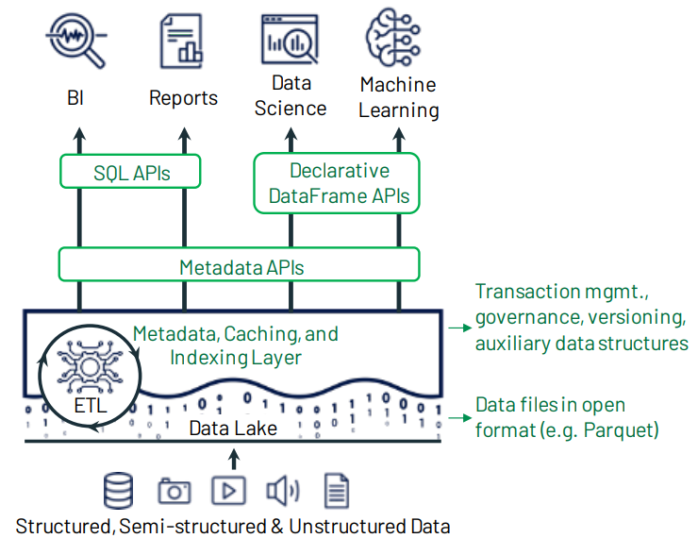
Data lakehouse
Metadata layer
On top of open file formats
Track which files are part of different table versions
Offer ACID-compliant transactions
Time travel feature
Data quality enforcement features (schema enforcement, custom contraints API)
Data that does not match this criteria could be rejected or moved to a dedicated location (Delta)
Governance features (access control, audit logging)

Slide 36

PROJECT PLAN
Roadmap of implementation of the To-Be solution
Project phases
Milestones and releases
Project Medotology
Project team

Slide 37




Project managament
Define a Goal
Define a Plan
Execute the Plan
Goal Achieved
Notes:
Structure a Project

Slide 38
Project management
In real cases
AI and ML subject to often overblown hype, no silver bullet to tackle lame processes or lack of data
Setting expectations, correcting them if necessary, helping to address
AP enabling use case, analysing the GAP
Focus on business value, who pays you if not
Challenging but realistic targets, cost, time and technology constraints
Define a Goal
Are you sure there is a goal?
Notes:
Are you sure there is a goal?
I have no idea what we have to do but we have to say by when we do it
Try to deliver something helpful
Check if really helpful

Slide 39
Project management
In real cases
Waterfall (does not work technically) or Agile (complex - no long-term visibility)? In the reality mix of the two, what changes (or should change) is the scope -> difficult realization
Define priorities, business value? Yes but given technical platform issue, promote E2E flows
Delivery VS Demand
Define a Plan
I have no idea what we have to do but we have to say when we do it
Notes:
Are you sure there is a goal?
I have no idea what we have to do but we have to say by when we do it
Try to deliver something helpful
Check if really helpful

Slide 40
Project management
In real cases
Change more or less everything compared to original plan
Change Scope
Change Priority
Change Timeline
Change resources (Senior Dev who knows everything quit)
…
Execute the Plan
Try to deliver something helpful
Notes:
Are you sure there is a goal?
I have no idea what we have to do but we have to say by when we do it
Try to deliver something helpful
Check if really helpful

Slide 41
Project management
In real cases
Just the first (or one of) iteraction
Define next steps
Application Maintenance
Tech Debt Analysis
Retrospective (why we have achieved some results and others have not)
Goal Achieved
Check if really helpful
Notes:
Are you sure there is a goal?
I have no idea what we have to do but we have to say by when we do it
Try to deliver something helpful
Check if really helpful

Slide 42
Thank you
www.reply.com

